Slide 1
Chapter 7. Parameter Estimation
7.1 The Method of Moments
7.2 Least Squares Estimation
7.3 Maximum Likelihood and Unconditional Least Squares
7.4 Properties of the Estimates
7.5 Illustrations of Parameter Estimation

Slide 2
7.1 The Method of Moments
Let Y₁, Y₂, …, Y_{n} denote the observed stationary process even though it may be an appropriate difference of the original series.
The method of moments consists of equating sample moments to corresponding theoretical moments and solving the resulting equations to obtain estimates of any unknown parameters.

Slide 3


7.1 The Method of Moments
Autoregressive Models
Suppose that {Y_{t}} follows the AR(1) model
Since ρ₁ = φ, by the method of moments, we have the estimate of φ to be given by
where r₁ is the lag 1 sample autocorrelation function.

Slide 4

7.1 The Method of Moments
In the case of AR(2) model,
The relationships between the parameters φ₁ and φ₂ and various moments are given by the Yule-Walker equations (4.3.10):
The method of moments replaces ρ₁ by r₁ and ρ₂ by r₂ to obtain

Slide 5
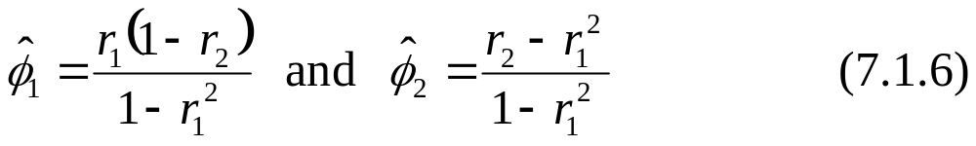
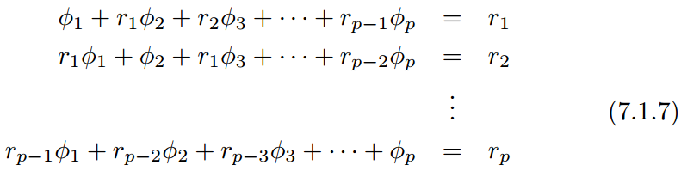

7.1 The Method of Moments
By solving Eq. (7.1.5), we obtain
For general AR(p) case, by replacing ρ_{i} with r_{i} in the Yule-Walker equations (4.3.25), we have
The linear equations are then solved for The corresponding estimates are called Yule-Walker estimates.

Slide 6

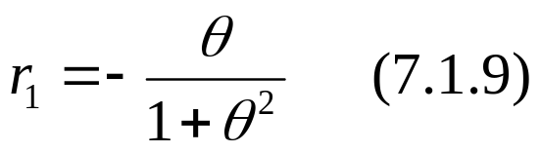
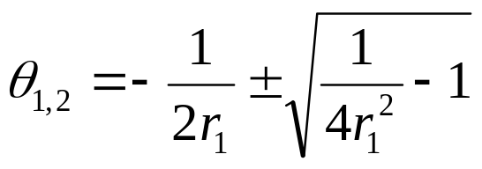
7.1 The Method of Moments
Moving Average Models
Suppose that {Y_{t}} follows the MA(1) model
By replacing ρ₁ with r₁ in Property (4) of the MA(1), we have
If |r₁| < 0.5, then we have two real roots for θ
Since θ₁θ₂ = 1, only one of the solutions satisfies the invertibility condition |θ | < 1.

Slide 7
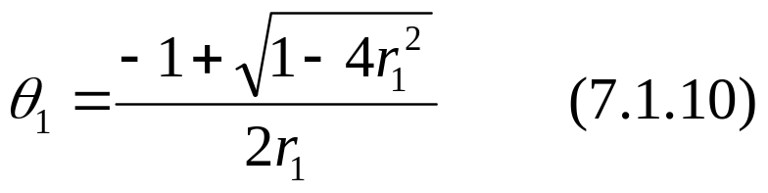

7.1 The Method of Moments
After further algebraic manipulation, the invertible solution can be written as
If r₁ = ± 0.5, then the unique, real solutions exist, namely
However, neither is invertible.
If |r₁| > 0.5 (which is certainly possible even though |ρ₁|<0.5), no real solutions exist, and so the method of moments fails to yield an estimator of θ.
Of course, if |r₁| > 0.5, the specification of an MA(1) model would be in considerable doubt.

Slide 8
7.1 The Method of Moments
For higher-order MA models, we can replace ρ_{k} by r_{k} in Property (3) of the MA(q) process to obtain q equations in q unknowns θ₁, θ₂, …, θ_{q}. However, the corresponding equations have to be solved numerically and have multiple solutions, of which only one is invertible. In general, the method of moments produces poor estimates for the MA models.

Slide 9
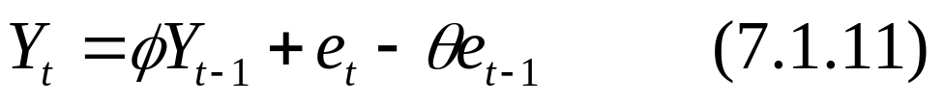
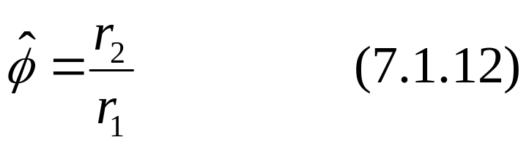

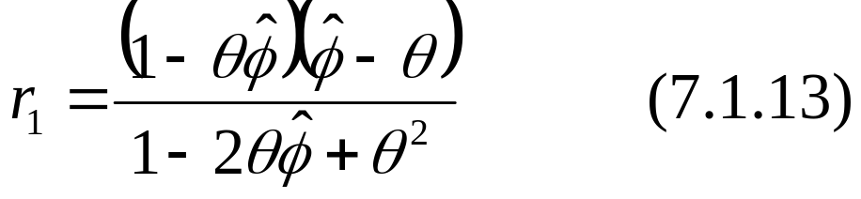
7.1 The Method of Moments
Mixed Models
Suppose that {Y_{t}} follows the ARMA(1, 1) model
Since ρ₂/ρ₁ = φ, we obtain
Use Eq. (4.4.5), we can solve from
A quadratic equation must be solved and only the invertible solution, if any, retained.

Slide 10
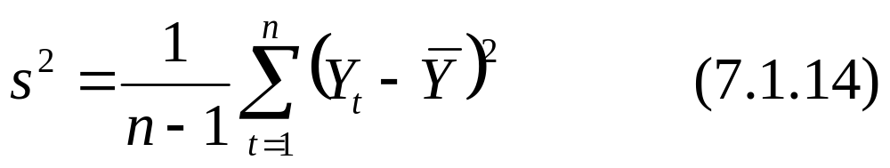
7.1 The Method of Moments
Estimates of the Noise Variance
The process variance γ₀ = Var(Y_{t}) is first estimated by the sample variance
AR(p) Model:
Eq. (4.3.26) yields

Slide 11

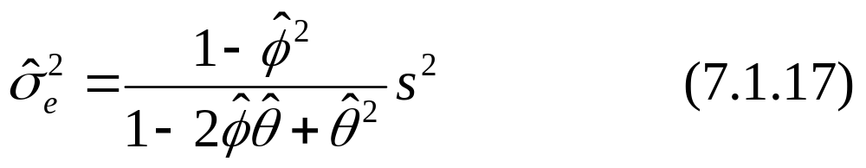
7.1 The Method of Moments
MA(q) Model:
Using Property (2) of the MA(q) process,
ARMA(1, 1) Model:
Eq. (4.4.4) yields

Slide 12
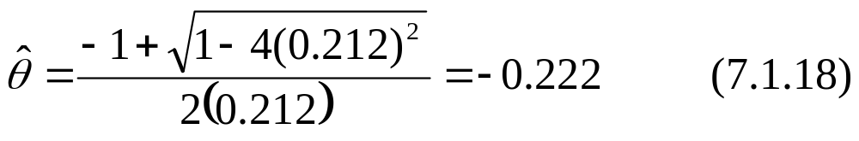
7.1 The Method of Moments
Example
Consider the oil price series, Exhibit 6.32 suggested that we specify an MA(1) model for the first difference of the logarithms of the series.
From Exhibit 6.32, r₁ = 0.212, so the method-of-moments estimate of θ is

Slide 13
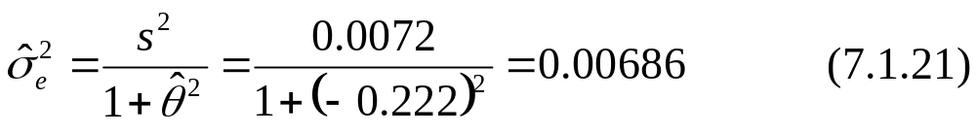
7.1 The Method of Moments
The mean of the differences of the logs is 0.004 and the variance is 0.0072.
or
with the estimated noise variance of

Slide 14

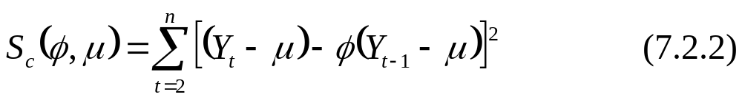
7.2 Least Squares Estimation
For many models, the method of moments is unsatisfactory, we must consider other methods of estimation.
Autoregressive Models
Consider the AR(1) model
Given the observed values of Y₁, Y₂, …, Y_{n}, the least squares estimates of μ and φ are obtained by minimizing the following conditional sum-of-squares function

Slide 15
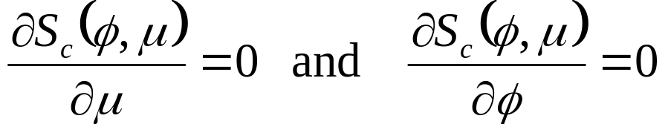
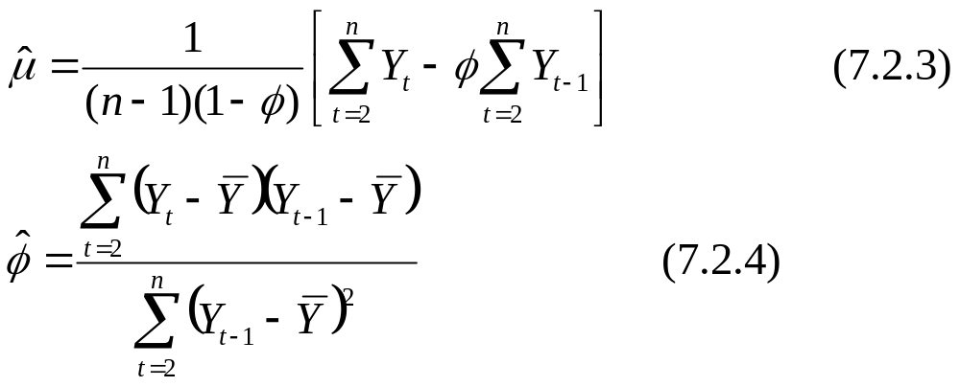
7.2 Least Squares Estimation
By solving the following equations for μ and φ , then we have their estimates

Slide 16
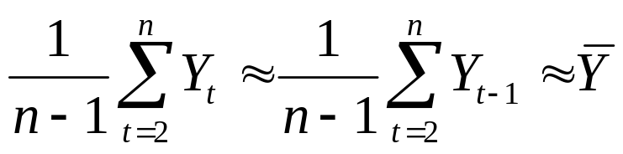
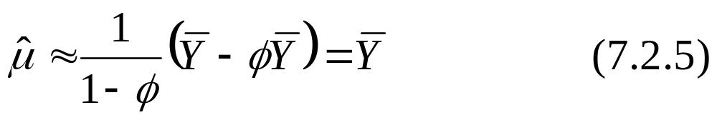
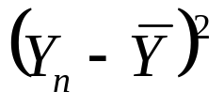
7.2 Least Squares Estimation
For large n,
Thus, regardless of the value of φ. Eq. (7.2.3) reduces to
Except for one term missing in the denominator of Eq. (7.2.4), namely , this is the same as r₁. Thus, the least squares and method-of-moments estimators are nearly identical for large n.

Slide 17

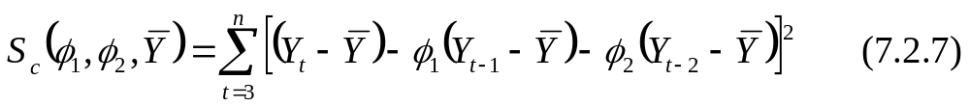
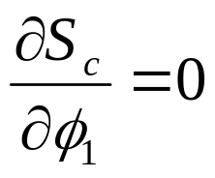
7.2 Least Squares Estimation
For the general AR(p) process, the methods used to obtain Eqs (7.2.3) and (7.2.5) can easily be extended to yield the same result, namely
To generalize the estimation of the φ’s, we consider the second-order model. Substitute Eq. (7.2.6) into the conditional sum-of-squares function, so
Setting , we have

Slide 18
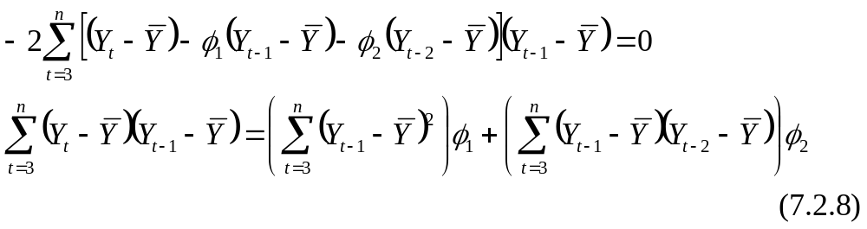
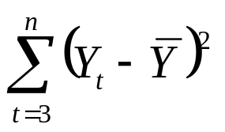

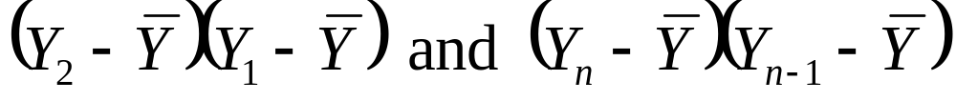
7.2 Least Squares Estimation
By dividing both sides of Eq. (7.2.8) by , we have
Rigorously, the terms are missed in the numerator of the first r₁ and the second r₁ respectively. However, these missing terms are negligible under the stationarity assumption.

Slide 19


7.2 Least Squares Estimation
Approximating in a similar way with the equation leads to
Eqs (7.2.9) and (7.2.10) are just the sample Yule-Walker eqs. for an AR(2) model.
Entirely analogous results follow for the general stationary AR(p) case: To an excellent approximation, the conditional least squares estimates of the φ’s are obtained by solving the simple Yule-Walker Eqs. (7.1.7).

Slide 20
7.2 Least Squares Estimation
Therefore, the conditional least squares estimates of the φ’s in the AR(p) model are regarded to be the same as the Yule-Walker estimates given by the method of moments.

Slide 21

7.2 Least Squares Estimation
Moving Average Models
The MA(1) model is given by
Unlike AR(p) case, we cannot apply the least squares method to Eq. (7.2.11). However, if it is an invertible MA(1) model, by using Eq. (4.5.1), Eq. (7.2.11) can be expressed as
an autoregressive model but of infinite order. Thus least squares can be meaningfully carried out by choosing a value of θ that minimizes

Slide 22
7.2 Least Squares Estimation
Note:
We will not be able to obtain the analytical solution of the least squares estimate of θ from Eq. (7.2.13) and must use the numerical techniques to solve it.
We do not have the explicit limits on the summation in Eq. (7.2.13) nor have we said how to deal with the infinite series under the summation sign.

Slide 23

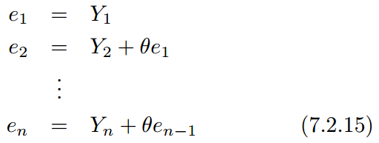
7.2 Least Squares Estimation
To address these issues, we rewrite Eq. (7.2.11) as
Assume e₀ = E[e_{t}] = 0. With the observed series, Y₁, Y₂, …, Y_{n}, we can obtain
and thus calculate S_{c}(θ) = ∑(e_{t})² , conditional on e₀ = 0, for that single given value of θ. The least squares estimate of θ can be obtained by carrying out the grid search over the invertible range (–1, +1).

Slide 24
7.2 Least Squares Estimation
For higher-order MA(q) models, we compute
e_{t} = e_{t}(θ₁, θ₂, …, θ_{q}) recursively from
with e₀ = e_{–1} = …= e_{–q} = 0.
The sum of squares is minimized jointly in θ₁, θ₂, …, θ_{q} using a multivariate numerical method.

Slide 25


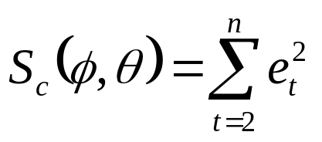
7.2 Least Squares Estimation
Mixed Models
Consider the ARMA(1, 1) case
Rewrite Eq. (7.2.17) as
To begin the recursion at t = 2, in order to avoid the assumption on Y₀, the least squares estimates of φ and θ can then be obtained from the minimization of

Slide 26

7.2 Least Squares Estimation
For the general ARMA(p, q) model, we compute
with e_{p} = e_{p – 1} = …= e_{p +1 – q} = 0 and then minimize
S_{c}(φ₁, φ₂, …, φ_{p}, θ₁, θ₂, …, θ_{q}) numerically to obtain the conditional least squares estimates of all the parameters.
For parameter sets θ₁, θ₂, …, θ_{q} corresponding to invertible models, the start-up values e_{p}, e_{p – 1}, …, e_{p +1 – q} will have very little influence on the final estimate of the parameters for large samples.

Slide 27


7.2 Least Squares Estimation
Estimates of noise variance:
where β₁, β₂ ,… ,β_{k} are the parameters of the model,
are the least square estimates of the β₁, β₂ ,… ,β_{k} and k is the number of the estimated parameters.
Example:
AR(1) model in Eq. (7.2.2): β₁ = μ , β₂ = φ, k = 2
MA(1) model in Eq. (7.2.13): β₁ = θ , k = 1

Slide 28
7.3 Maximum Likelihood and Unconditional Least Squares
For the sample with moderate size, the start-up values
e_{p}= e_{p – 1}= …=e_{p +1 – q} = 0 will have a more pronounced effect on the final estimates for the parameters.
The advantage of the maximum likelihood is that all of the information in the data is used rather than just the first and second moments, as in the case with least squares.
However, the disadvantage is that we must for the first time work specifically with the joint probability density function of the process.

Slide 29
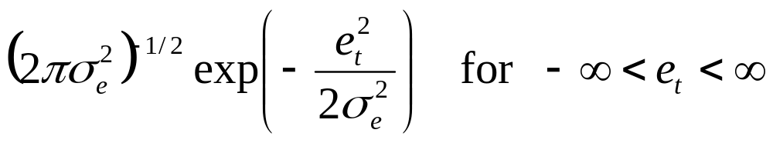
7.3 Maximum Likelihood and Unconditional Least Squares
Maximum Likelihood Estimation
AR(1) Model:
Assumption:
The white noise terms {e_{t}} are independent, normally distributed random variables with zero means and common standard deviation σ_{e}.
The pdf of each e_{t} is then

Slide 30
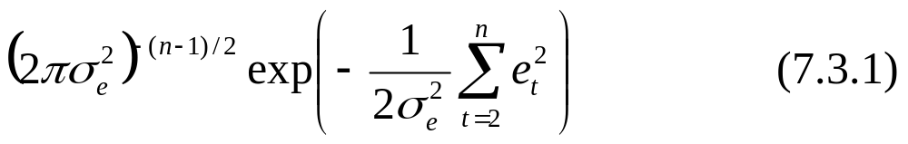
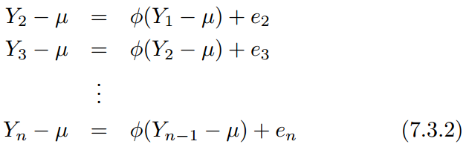
7.3 Maximum Likelihood and Unconditional Least Squares
And, by independence, the joint pdf for e₂, e₃, …, e_{n} is
Now consider

Slide 31
7.3 Maximum Likelihood and Unconditional Least Squares
If we condition on Y₁ = y₁, Eq. (7.3.2) defines a linear transformation between e₂, e₃, …, e_{n} and Y₂, Y₃, …, Y_{n} (with Jacobian equal to 1).
Thus the joint pdf of Y₂, Y₃, …, Y_{n} given Y₁ = y₁ can be obtained by using Eq. (7.3.2) to substitute for the e’s in terms of the Y’s in Eq. (7.3.1). Thus we get

Slide 32
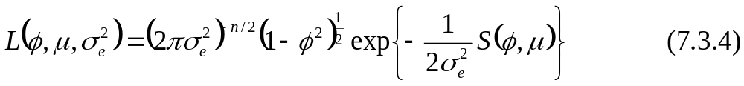
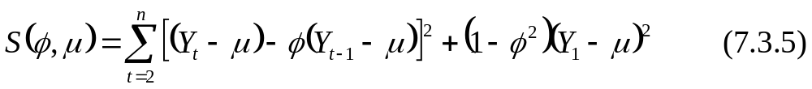
7.3 Maximum Likelihood and Unconditional Least Squares
It follows from the linear process representation of the AR(1) process in Section 4.3 that Y₁ will have a normal distribution with mean μ and variance σ_{e}²/(1 – φ ²).
The likelihood function L(φ, μ, σ_{e}²) for an AR(1) model is obtained by multiplying the conditional pdf in Eq. (7.3.3) by the marginal pdf of Y₁.
where the unconditional sum-of-squares function S(φ, μ) is given by

Slide 33
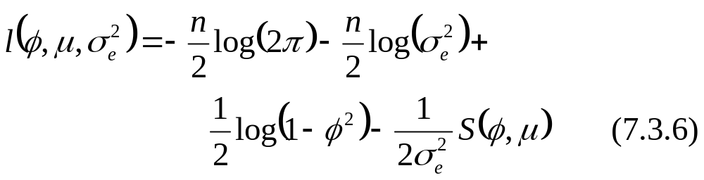
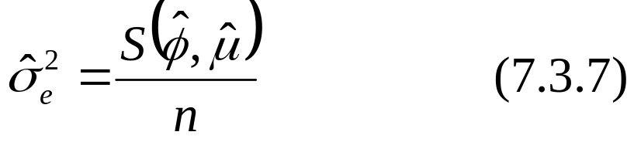
7.3 Maximum Likelihood and Unconditional Least Squares
The log-likelihood function, denoted l(φ, μ, σ_{e}²), is given by
For given values of φ and μ, l(φ, μ, σ_{e}²) can be maximized analytically with respect to σ_{e}² in terms of the yet-to-be-determined estimators of φ and μ. We obtain

Slide 34
7.3 Maximum Likelihood and Unconditional Least Squares
Comparing with the conditional sum-of-squares function S_{c}(φ, μ) in Eq. (7.2.2), we have
For large sample sizes, S(φ, μ) ≈ S_{c}(φ, μ). Thus the values of φ and μ that minimize S(φ, μ) or S_{c}(φ, μ) should be very similar.
The effect of the rightmost term in Eq. (7.3.8) will be more substantial when the minimum of φ occurs near the stationarity boundary of ±1.
For the general ARMA model, the derivation of the likelihood function is considerably more involved.

Slide 35
7.3 Maximum Likelihood and Unconditional Least Squares
Unconditional Least Squares
The estimates of φ and μ obtained from the minimization of S(φ, μ ) are called unconditional least squares estimates. The presence of the term (1 – φ²)(Y₁ – μ)² in Eq. (7.3.5) causes the equations ∂S/∂φ = 0 and ∂S/∂μ = 0 to be nonlinear in φ and μ. Thus, the minimization must be carried out numerically.

Slide 36
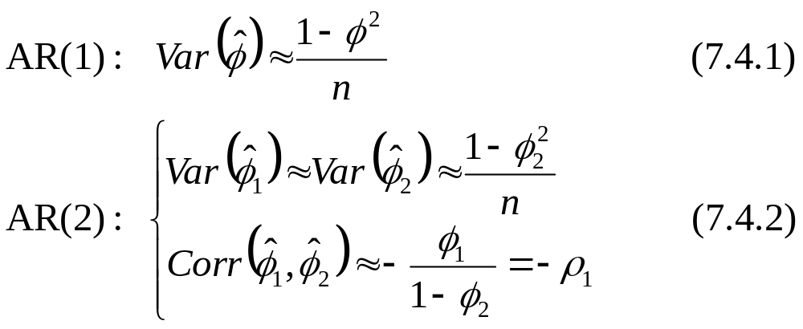
7.4 Properties of the Estimates
The large-sample properties of the maximum likelihood and least squares (conditional or unconditional) estimators are identical.
For large n, the estimators are approximately unbiased and normally distributed. The variances and correlations are as follows:

Slide 37
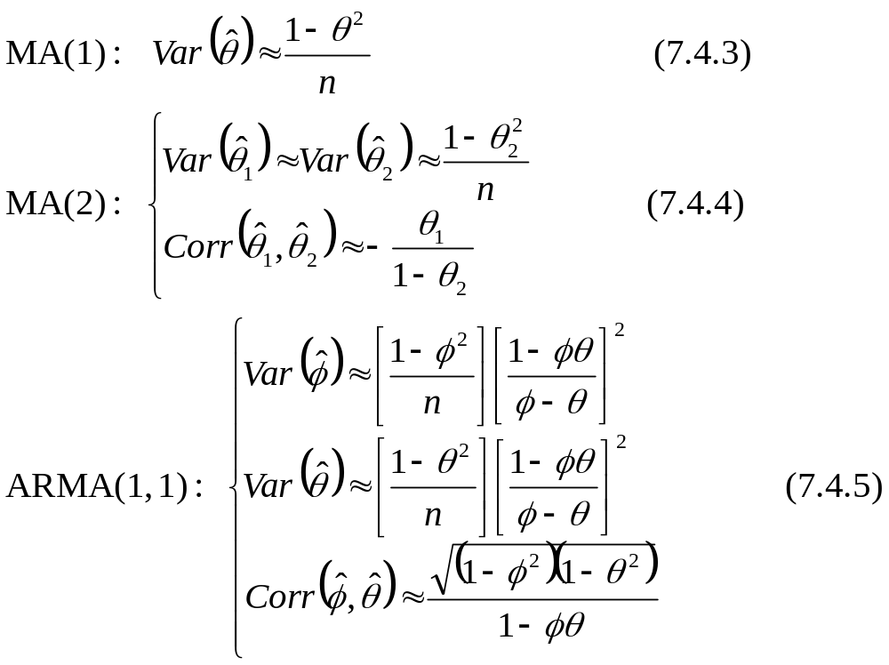
7.4 Properties of the Estimates

Slide 38
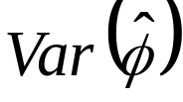
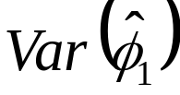
7.4 Properties of the Estimates
In the AR(1) case, decreases as φ approaches ±1.
Even though an AR(1) model is a special case of an AR(2) model with φ₂ = 0, the in Eq. (7.4.2) shows that our estimation of φ₁ will generally suffer if we erroneously fit an AR(2) model when, in fact, φ₂ = 0. Similar comments could be made between MA(1) and MA(2), and also among an ARMA(1, 1), MA(1) or AR(1) model.
If φ and θ are nearly equal in the ARMA(1, 1) case, the variability in the estimators of φ and θ can be extremely large.
In all of the two-parameter models, the estimates can be highly correlated even for large sample sizes.

Slide 39
7.4 Properties of the Estimates
For stationary autoregressive models, the method of moments yield estimators equivalent to least squares and maximum likelihood, at least for large samples.
For models containing moving average terms, the variance of the method-of-moments estimators is larger than variance of the maximum likelihood estimators.

Slide 40
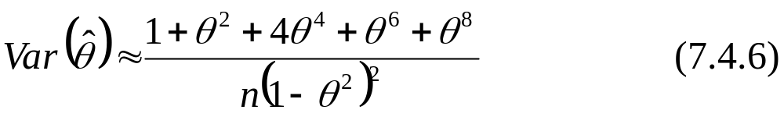
7.4 Properties of the Estimates
Example
(Method of Moments (MM) vs. Maximum Likelihood (MLE))
Consider an MA(1) model, it can be shown that the large-sample variance of the method-of-moments estimator of θ is equal to
Comparing Eq. (7.4.6) with Eq. (7.4.3), we have the following table

Slide 41
7.4 Properties of the Estimates
where
SD_{MM}: standard deviation of the method-of-moments estimator.
SD_{MLE}: standard deviation of the maximum likelihood estimator.
θ | SD_{MM} / SD_{MLE}
0.25 | 1.07
0.50 | 1.42
0.75 | 2.66
0.90 | 5.33

Slide 42
7.5 Illustrations of Parameter Estimation
Example 7.5.1
Consider the simulated MA(1) series with θ = –0.9 in Exhibit 4.2. We found
 | Estimates
Parameter θ | Method- of-Moments | Conditional SS | Unconditional SS | Max. Likelihood
–0.9 | –0.554 | –0.879 | –0.923 | –0.915

Slide 43
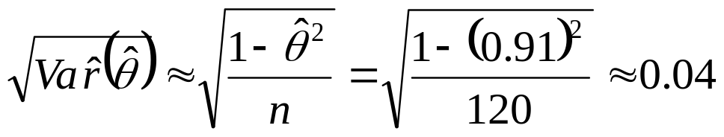
7.5 Illustrations of Parameter Estimation
Using Eq. (7.4.3), we have the standard error of about
so none of the maximum likelihood, conditional sum-of-squares, or unconditional sum-of-squares estimates are significantly far from the true value of –0.9.

Slide 44
7.5 Illustrations of Parameter Estimation
Example 7.5.2
Consider the Canadian hare abundance series. Based on the partial autocorrelation function for square root of the series in Exhibit 6.29, we will estimate an AR(3) model. The maximum likelihood estimates are given in Exhibit 7.8

Slide 45
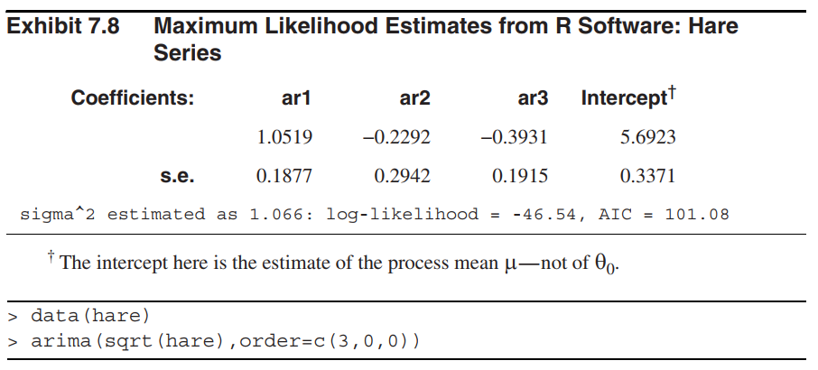
7.5 Illustrations of Parameter Estimation

Slide 46
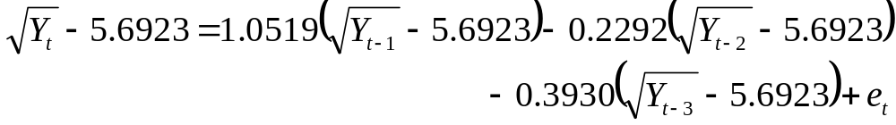
7.5 Illustrations of Parameter Estimation
The estimated model is given by
or
where Y_{t} is the hare abundance in year t in original terms.

Slide 47
7.5 Illustrations of Parameter Estimation
From Exhibit 7.8, the standard error shows that the estimates of the lag 1 and lag 3 autoregressive coefficients are significantly different from 0, as is the intercept term.
However, the lag 2 autoregressive parameter estimate is not significant different from 0.
It is suggested to set φ₂ = 0 and obtain new estimates of φ₁ and φ₃ with this subset model.

Slide 48
7.5 Illustrations of Parameter Estimation
Example 7.5.3
Consider the oil price series in Exhibit 5.1. The sample ACF shown in Exhibit 6.32, suggested an MA(1) model on the differences of the logs of the prices. The estimates of θ by the various methods are given by
 | Estimates (n = 241)
Parameter | Method- of-Moments | Conditional SS | Unconditional SS | Max. Likelihood
θ | –0.2225 | –0.2731 | –0.2954 | –0.2956

Slide 49
7.5 Illustrations of Parameter Estimation
The method-of-moments estimate differs quite a bit from the others. The others are nearly equal given their standard errors of about 0.07.

Slide 50
Summary
Method of moments (MM)
  Estimate the coefficients and noise variance
  Method of moments produces poor estimates for the MA models
Conditional least squares (LS) estimation
  Conditional least squares estimates of coefficients in the AR(p) model are the same as those obtained by the method of moments.
  For large samples, the start-up values of disturbance terms have little influence on the final estimate of parameters of invertible MA or ARMA models
  For samples with moderate sizes, the start-up values of disturbance terms have a more pronounced effect on the final estimates for the parameters.

Slide 51
Summary
Maximum likelihood (ML) estimates
  The advantage is that all of the information in the data is used rather than just the first and the second moments.
  The disadvantage is that we must work with the joint pdf of the process
  Large-sample properties of the maximum likelihood and least squares (conditional or unconditional) estimators are identical

Slide 52
Summary
Properties of the estimates
  For stationary AR models, MM yield estimators equivalent to LS and ML, at least for large samples.
  For MA and ARMA models, the variance of MM estimators is larger than variance of the ML estimators.
  In summary
    For AR models, MM, LS, ML methods generate similar results.
    For MA and ARMA models, it is better to use LS (both conditional and unconditional for large samples; unconditional for moderate samples) or ML methods.

